Slide 1
DNA Encryption: Bioencryption to Store Your Secrets in Living Organisms

Slide 2
About Me
@JohnDunlap2
Security Researcher
Reverse Engineer
Avid collector of bad software
Work for GDSSecurity doing code review / RE / Research / pentesting

Slide 3
Let’s be clear

Slide 4
What I am
Hacker in the traditional sense
Researcher of hacker history (watch my hope conf talk when it comes out!)
Programmer
Curious
Stubborn
Perhaps Foolhardy

Slide 5
What I am not
A biologist
A geneticist
A lab professional
A cryptographer
Dissuaded from synthesizing DNA of my own design by any of the above facts.

Slide 6
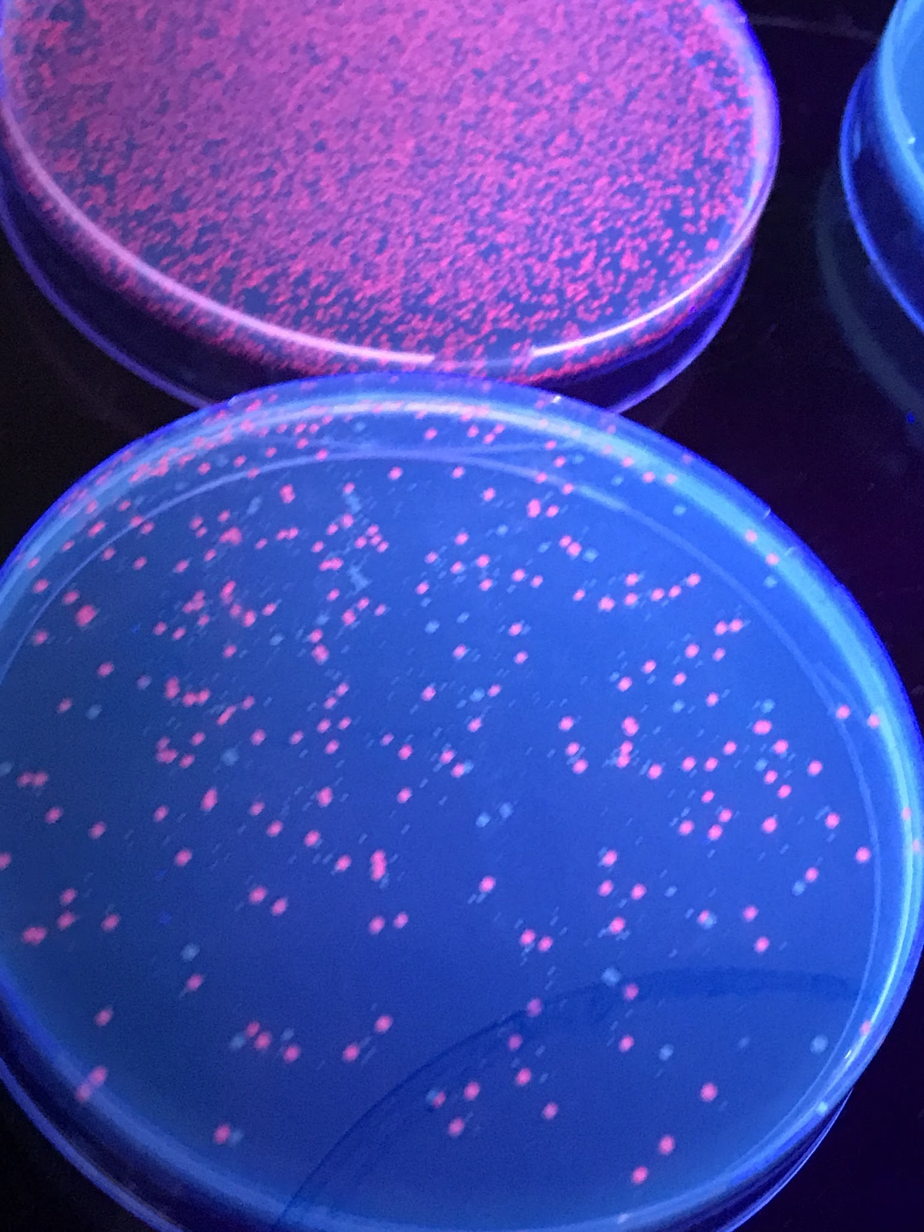
The Impetus for This Talk

Slide 7
Community Biohackerspaces are awesome!
Please support them
Be responsible
Special shout outs to Mike & Will at Genspace for helping me out with all of this

Slide 8
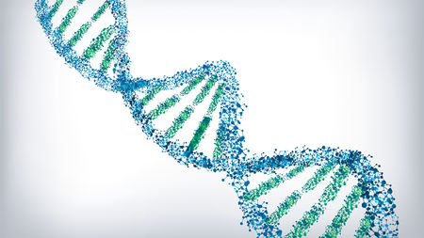
DNA Data Storage

Slide 9

I am going for something more modest. Hacker Style!

Slide 10
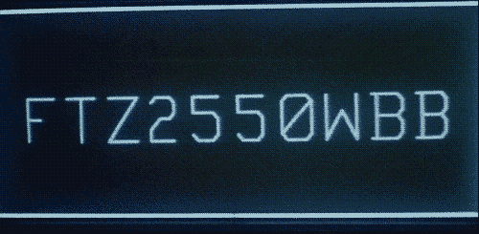
My Dream Attack

Slide 11
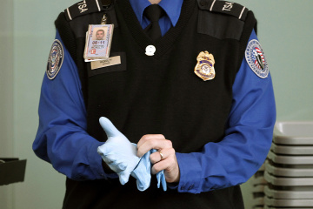
But how to get them through?

Slide 12
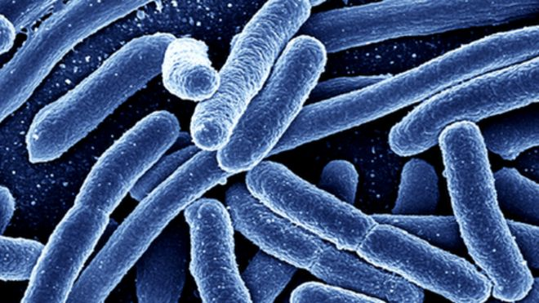
Biological Encryption

Slide 13
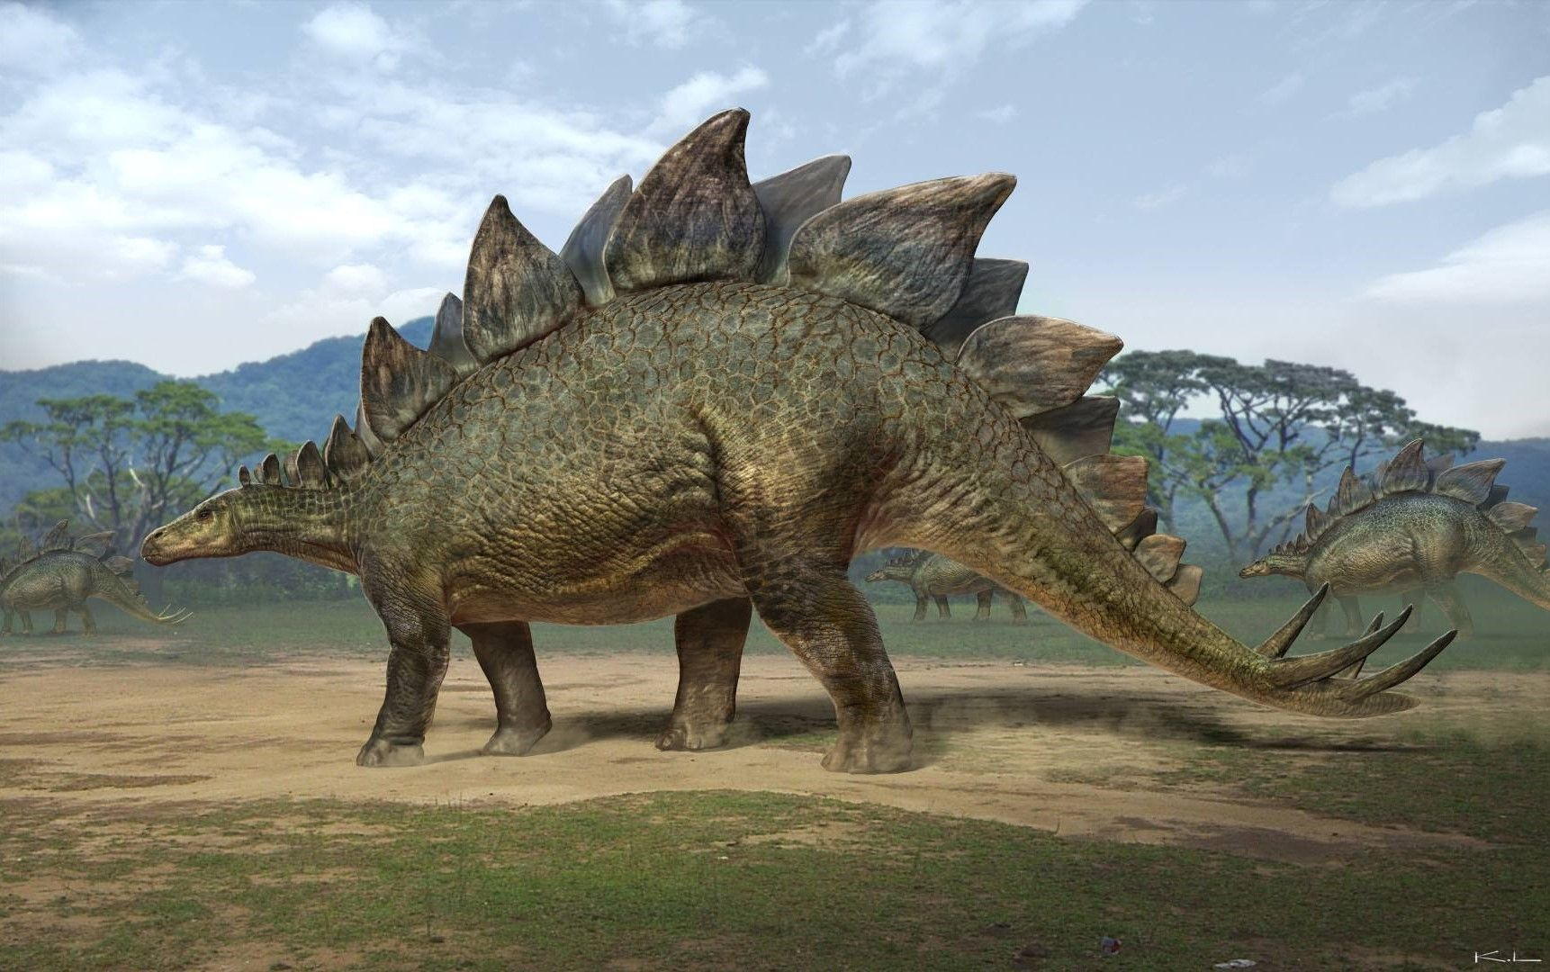
Living Stego

Slide 14
People have been trying this on a research/experimental level for a while
http://www.csl.sri.com/users/gehani/papers/DIMACS-1999.DNACrypto.pdf Gehani 1999 - good list of early experiments / papers
https://ieeexplore.ieee.org/document/1205146/ Jie Chen 2003 “DNA Based Biomolecular Cryptography Design”

Slide 15
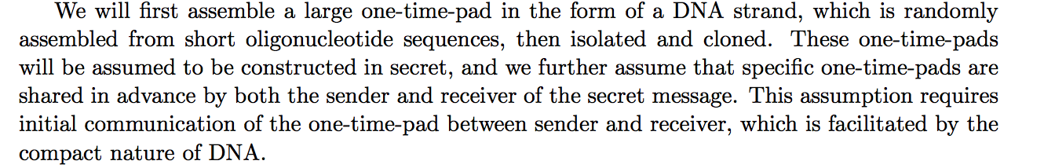
I am not the first to try (Gehani, 1999)

Slide 16
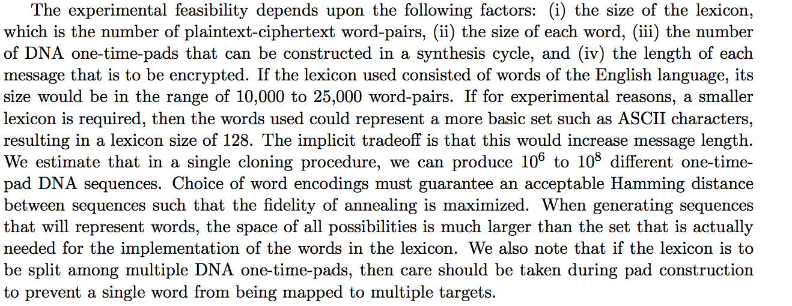
More

Slide 17
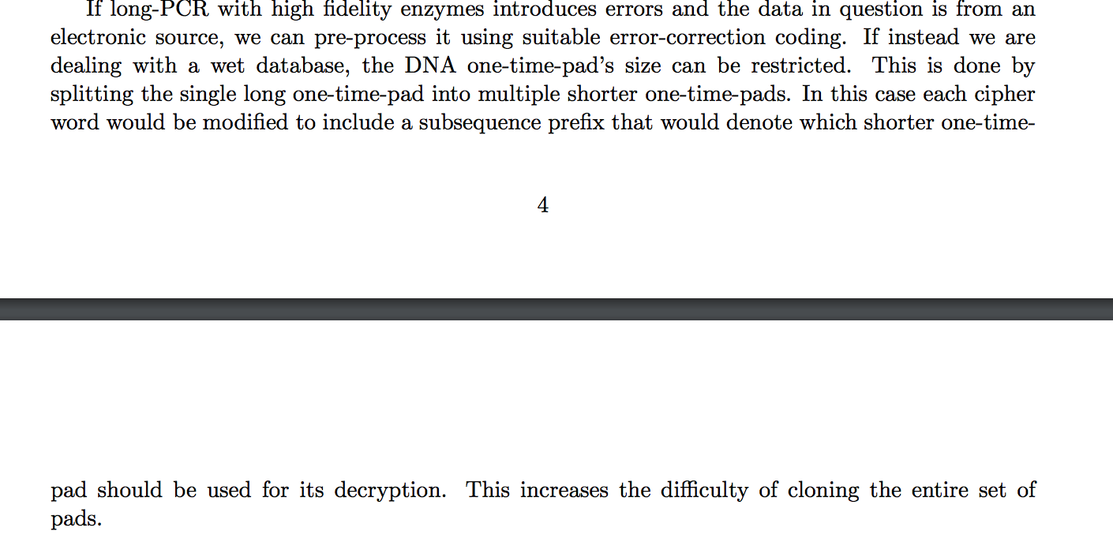
DNA Chips

Slide 18
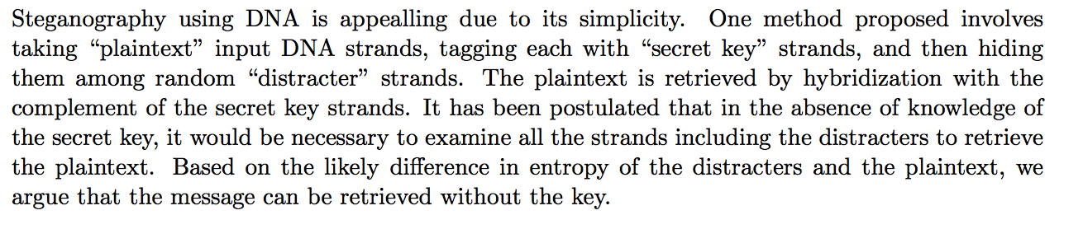
Stego was proposed back in 1999 at least

Slide 19
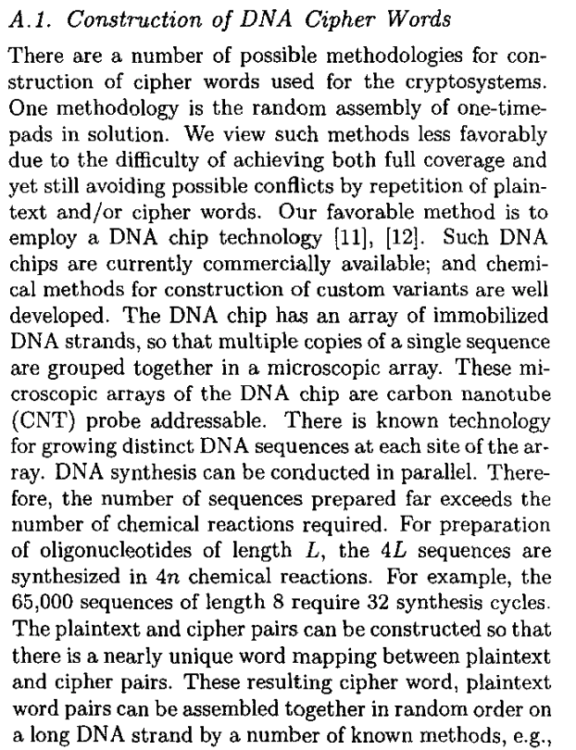
2003, Jie Chen

Slide 20
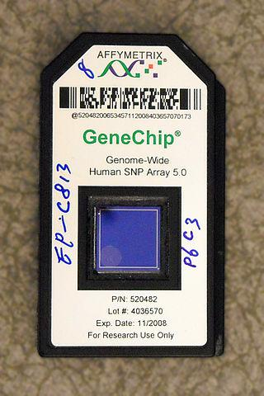
DNA Chip

Slide 21
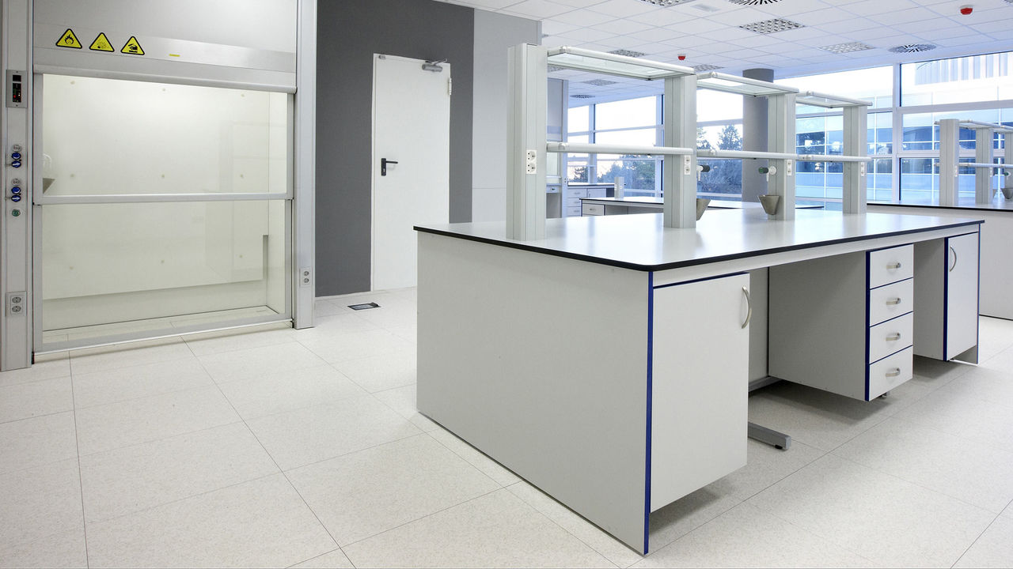
Lots of crypto papers but not many reports of experiments…

Slide 22
My Idea: Do it small. Do it simple.
Don’t have the lab, the funding, the team of grad students for microarrays
I’m going to cook some cryptography up in an E.Coli culture in a way that’s replicable on a DIYish scale
Edit a plasmid via restriction enzyme digestion.
Sequence the culture and see if I can get the plain text back out.
Giggle madly?

Slide 23
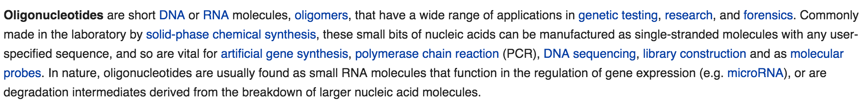
Oligos?

Slide 24
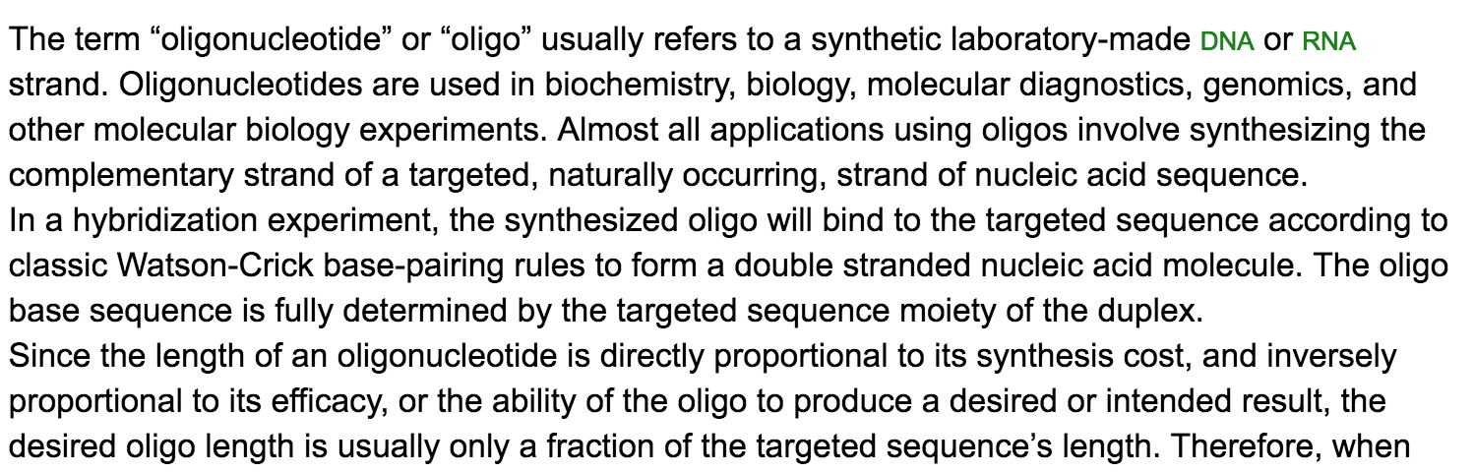
Biosyn has a FAQ on this

Slide 25
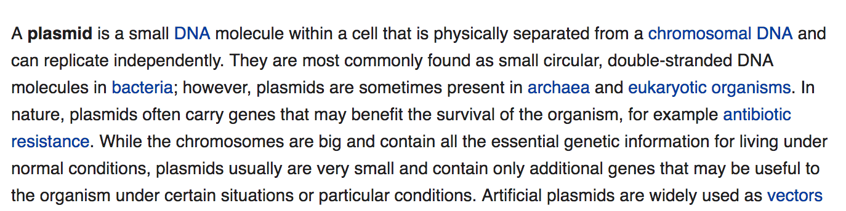
Plasmid

Slide 26
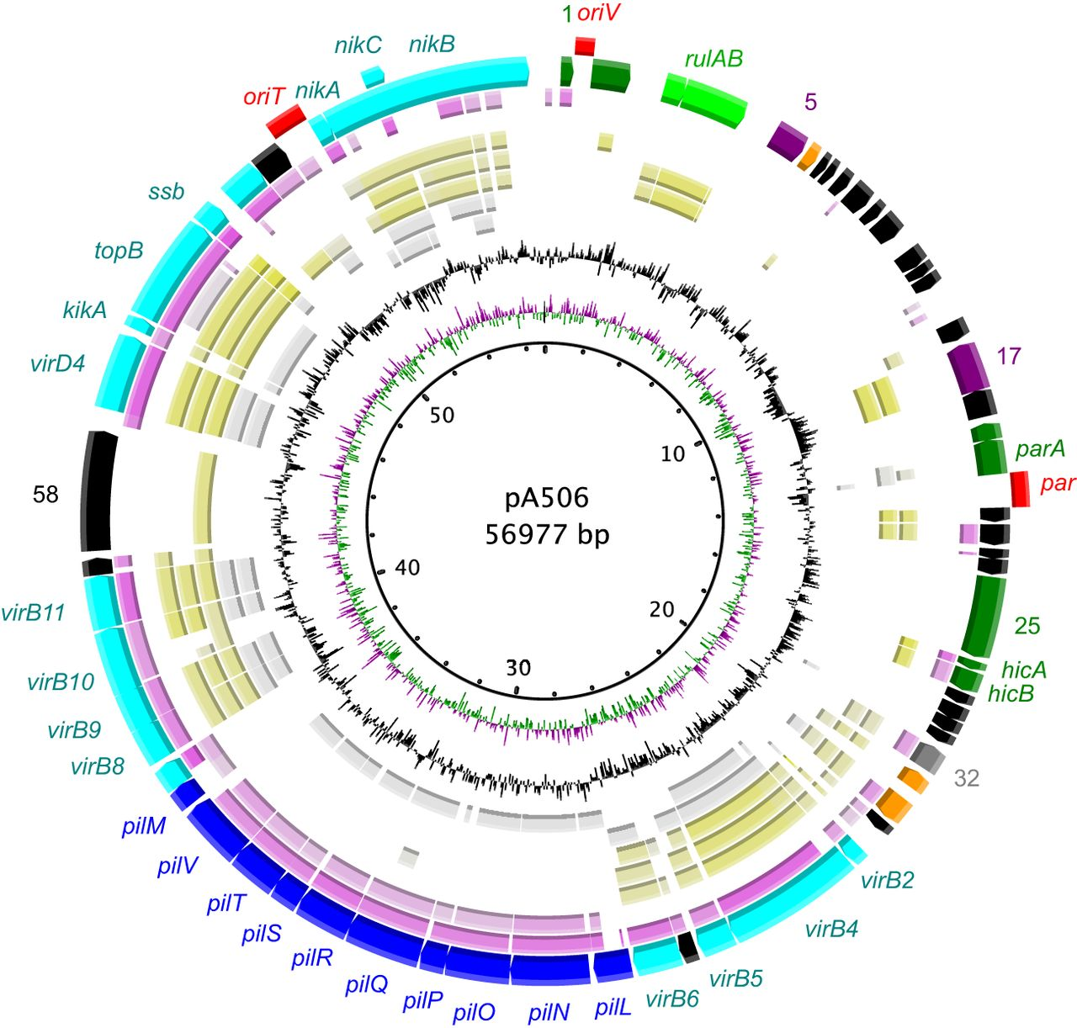
Think DNA Donut

Slide 27
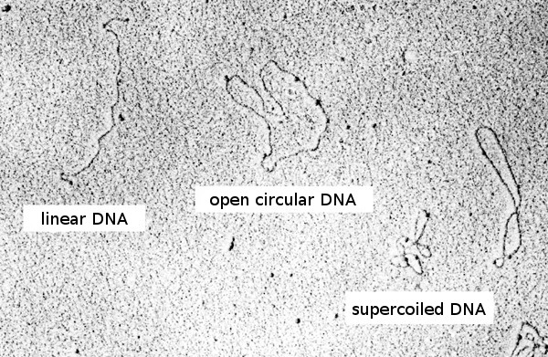
SEM Plasmid

Slide 28
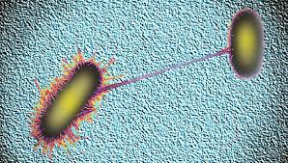
Bacteria sharing plasmids via conjugation

Slide 29
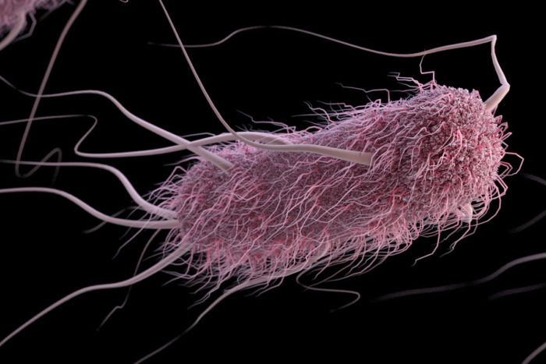
Step 1: Pick an Amenable Model Organism

Slide 30
Step 2: Pick an amenable encryption strategy
Requirements include: Small size, low complexity, high integrity, low cost
Low cost
Low cost
Something I can do in a community lab

Slide 31
Constraints of Affordable Synthesis
Size – anything above about 60 nucleotides gets much more expensive and complex
No repeating patterns
No self compliments / palindromes

Slide 32
Algorithms That Wont Work
AES/DES – too big
Any kind of public key crypto – I don’t want to synthesize a bunch of oligos to implement key sharing. Also too long.

Slide 33
Professional cryptographers are coming up with a way to do those though
People are coming up with some novel methods of hiding keys in DNA
Attempts at all modern forms of cryptography, at least on the theoretical level have been proposed.
I haven’t seen anyone document doing it in a lab

Slide 34
One Time Pad
It can be small
It can be perfect
I don’t want to implement the key sharing in the DNA due to complexity and expense. We will assume the conspirators have little padbooks like back in the day.
The sheer data density of DNA gives an attractive level of obscurity even if we know that we shouldn’t rely on that.

Slide 35
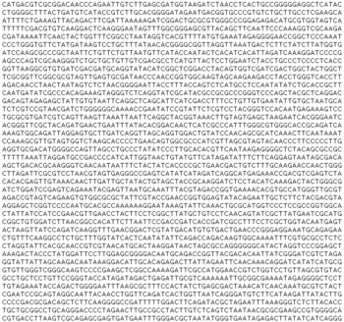
Step 3: Design Message Encoding Options

Slide 36
Nucleotides
We want to convert ascii strings into ACGT
How we do this will determine the density of data we can encode

Slide 37
Base 4
Value | Acid
0 | Adenine
1 | Cytosine
2 | Guanine
3 | Thymine

Slide 38
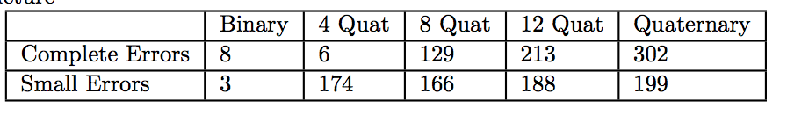
Side note: I had no idea people called b4 integers quats. This is amusing to me.

Slide 39
Byte Width
Depending on how big our bytes are we can encode different quantities of information
I prefer a four quat bytes (qytes? Crumb? Quites?)
4 quat bytes can represent the entire ascii table

Slide 40
Comparison
Byte Size | Max Int | Max Message Size for 32 bp | It can represent…
4 | 256 | 8 | Ints, full ascii table
3 | 64 | 10 | Most alphabets with some wiggle room for other stuff
2 | 16 | 16 | Viable subset of English letters

Slide 41
Step 4: Design a primer
I want to do PCR so the rest of the oligo will help with the primer
20 nt primer binding site (random)
20 nt reverse primer (compliment)
Primer Binding site -> payload -> reverse primer
The lab I contacted me assured this would work with their in house plasmid and universal primer.
They also gave me a lot of help and advice. They are very nice people.
Literally taught me all of this stuff.

Slide 42
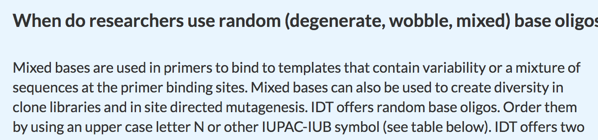
IDT has a good explanation

Slide 43
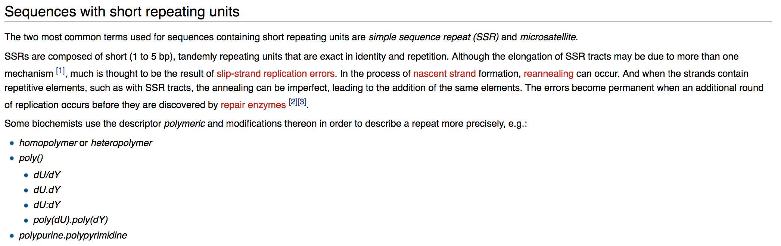
Repeating Sequences (Bioinformatics wiki)

Slide 44
Self Compliments are Bad
Some sequencing techniques will generate significant errors when you do this

Slide 45
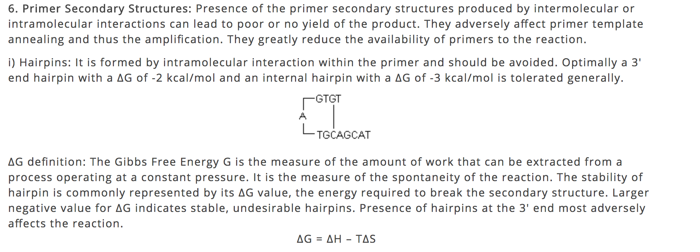
Biosoft explains this better than I do

Slide 46
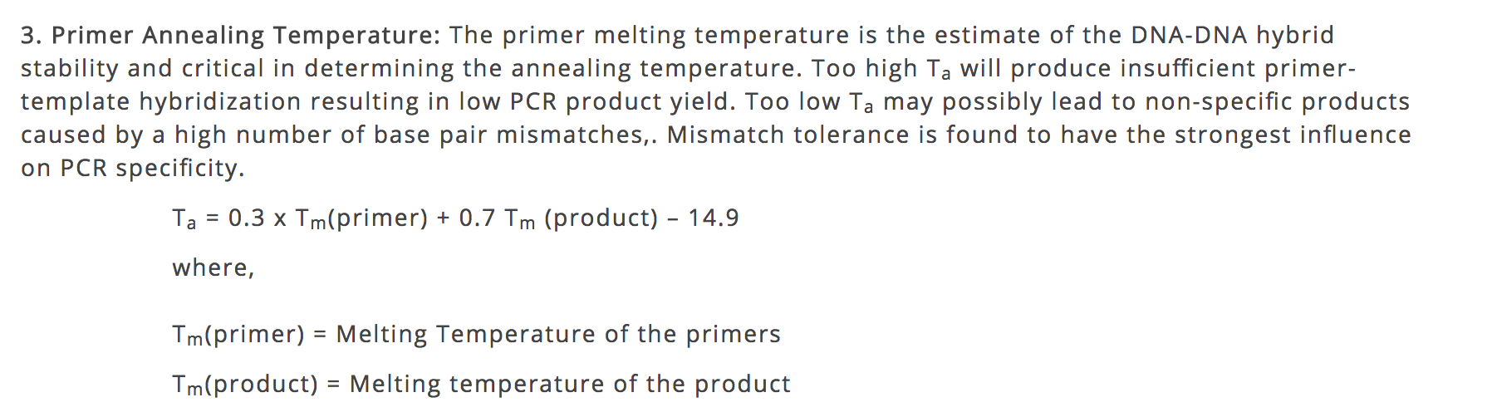
Temperature

Slide 47
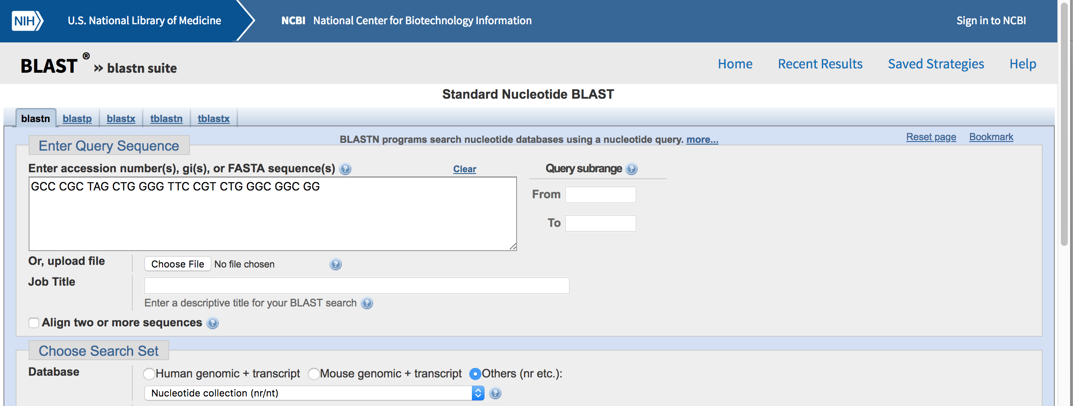
BLAST

Slide 48
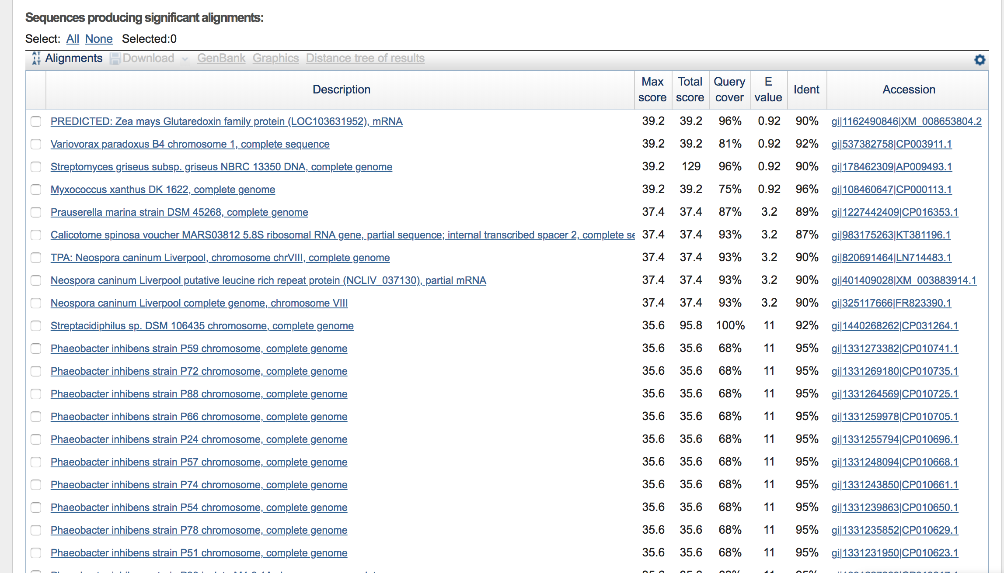
Stuff BLAST finds

Slide 49
I’m a programmer so I automated
Converts ASCII into one time pad
Fill in any blanks
Base 4 it
Add the one time pad
Configurable byte size
Decrypts as well

Slide 50
You can grab my script on github
https://github.com/MrSynAckSter/CryptoPlasmid

Slide 51
Small PoC
We will convert some 1337 $p34k into DNA, because that amuses me.
A commercial synthesis company actually already made this 1337 infected DNA. There were no complaints over my s1ck w4r3z
The tool doesn’t do some of the more robust structural checks on the DNA (self compliment, temperature, etc…) – if people are interested I may implement some of that.

Slide 52
The Key
One time pad.
Same size as message.
User Specified.
You’ll have plenty of time between ordering oligos to figure out the next key.

Slide 53
The Params
Plaintext: 1337f347 - because we accomplished something cool.
Key: cryptkid – because we are using a script to become a genetic engineering script kiddy

Slide 54
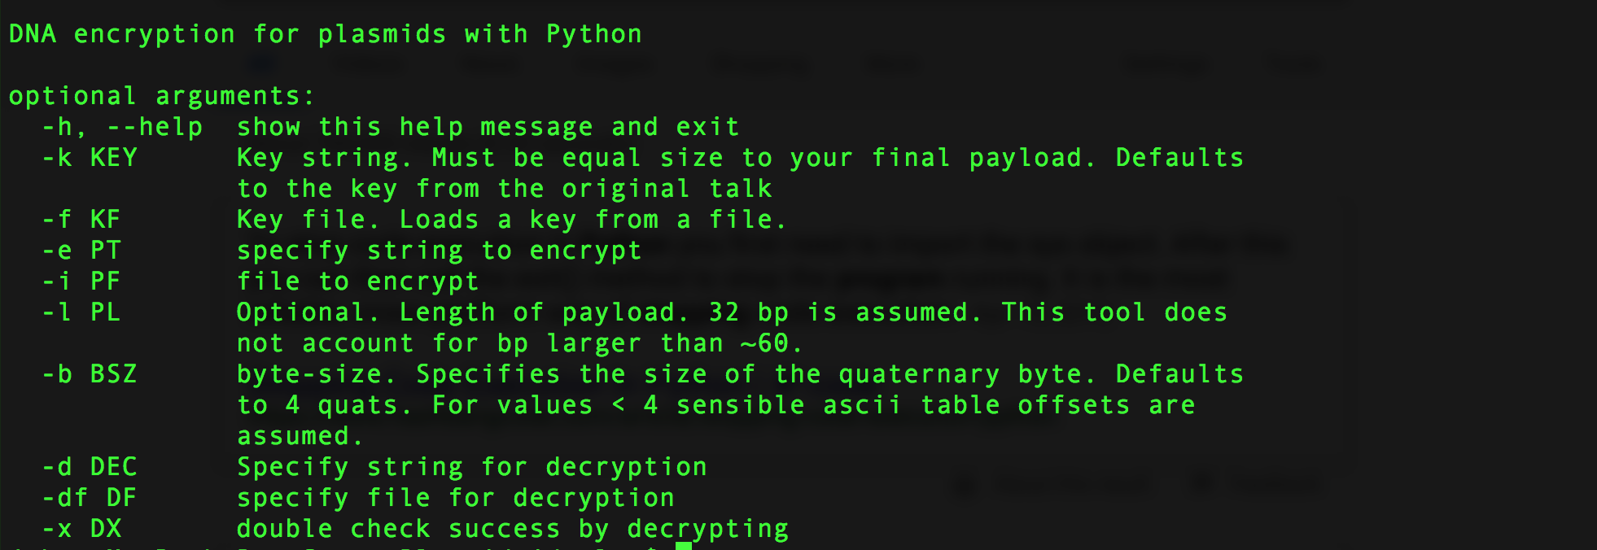
Help / Args

Slide 55
Running

Slide 56
Decrypting

Slide 57
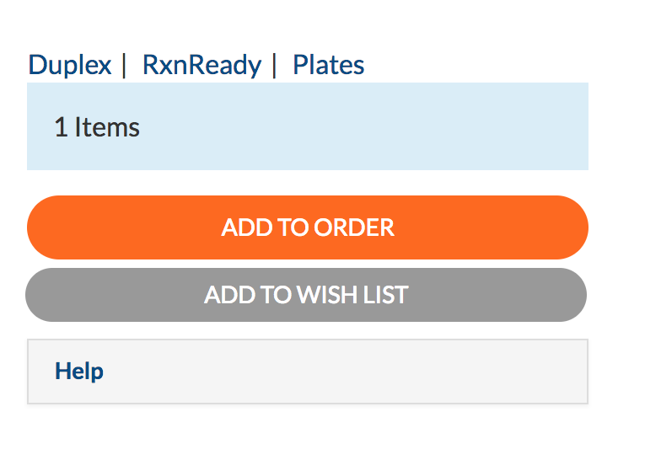
Step 5: Ordering DNA for Synthesis

Slide 58
You can’t actually just do this
Synthesis providers typically only sell to labs
You will have to develop a relationship with a lab in good standing with a synthesis provider in order to buy the DNA
The scientific industry is actually very responsible when it comes to checking up on sketchy people trying to order DNA / Lab equipment / chemicals
On a positive note the ordering forms often have nifty validation suites to help make sure your DNA is viable

Slide 59
It would be pretty tough to do the synthesis on your own
I hear the chemicals are pretty nasty and it’s not easy.
Commercial synthesis is cheap enough that it’s not worth the trouble/danger/expense/equipment
Wasn’t really an option for me.

Slide 60
Step 6: Editing E. Coli
Use a restriction enzyme to edit a plasmid
Basically the original DNA editing technique
Essentially snip the plasmid leaving some “sticky ends” which our synthetic DNA may attach to
Exactly like the class I took. Recreate intro to gene hacking experiment with our encrypted ASCII data integrated into the plasmid

Slide 61
A Vague High Level Lab Strategy
https://www.genscript.com/restriction-digestion-protocol.html has a wonderful summary of what you would do. It’s a good site to read layman accessible versions of this stuff
I ended up asking a lot of questions and needing a lot of help. Having a lab buddy who knows what they are doing is a good thing.

Slide 62
Lab pics
Stop for pictures here if time permits

Slide 63
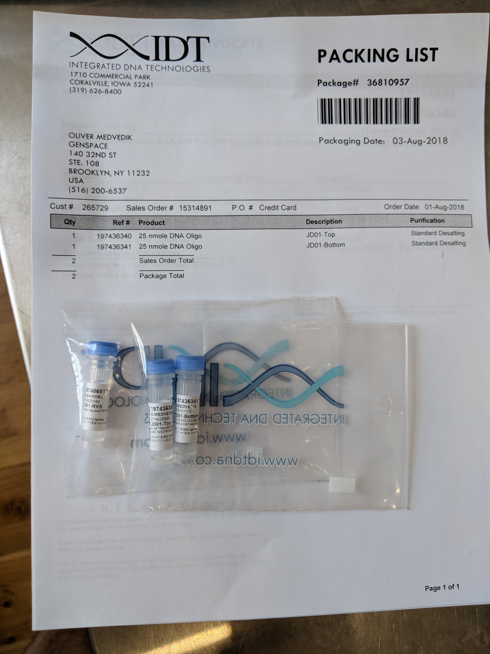
Muh DNA!

Slide 64
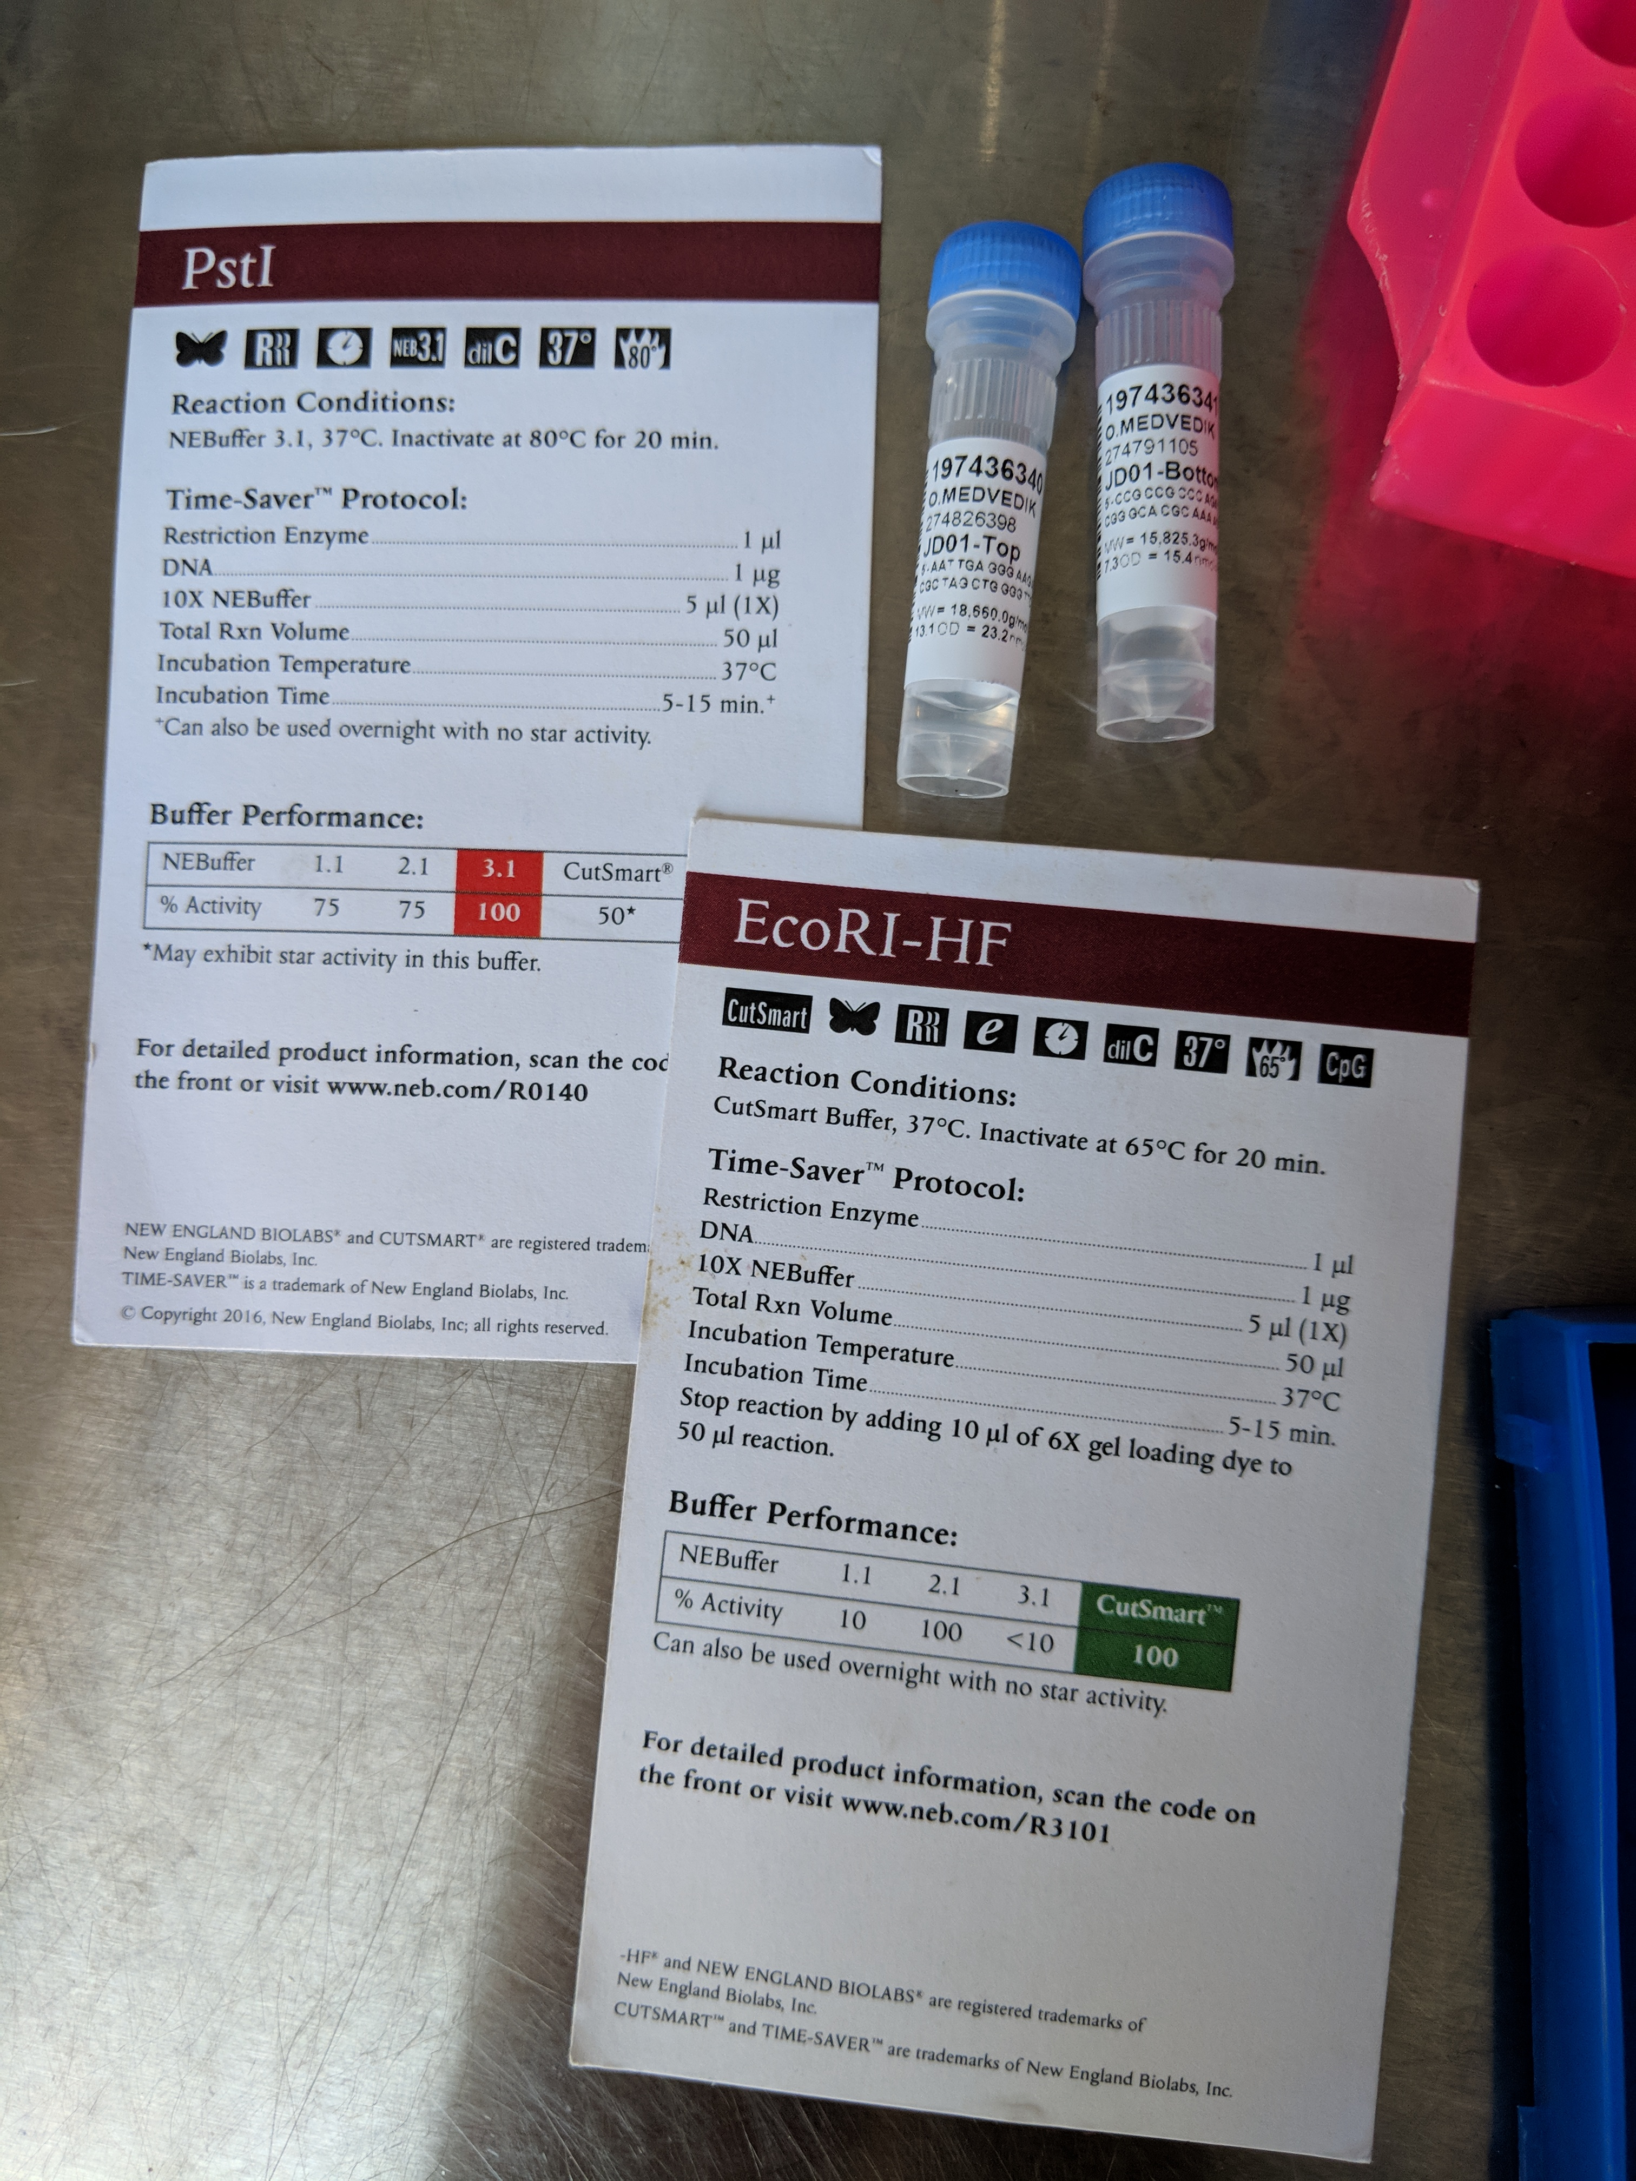
THE BUILDING BLOCKS OF LIFE!

Slide 65
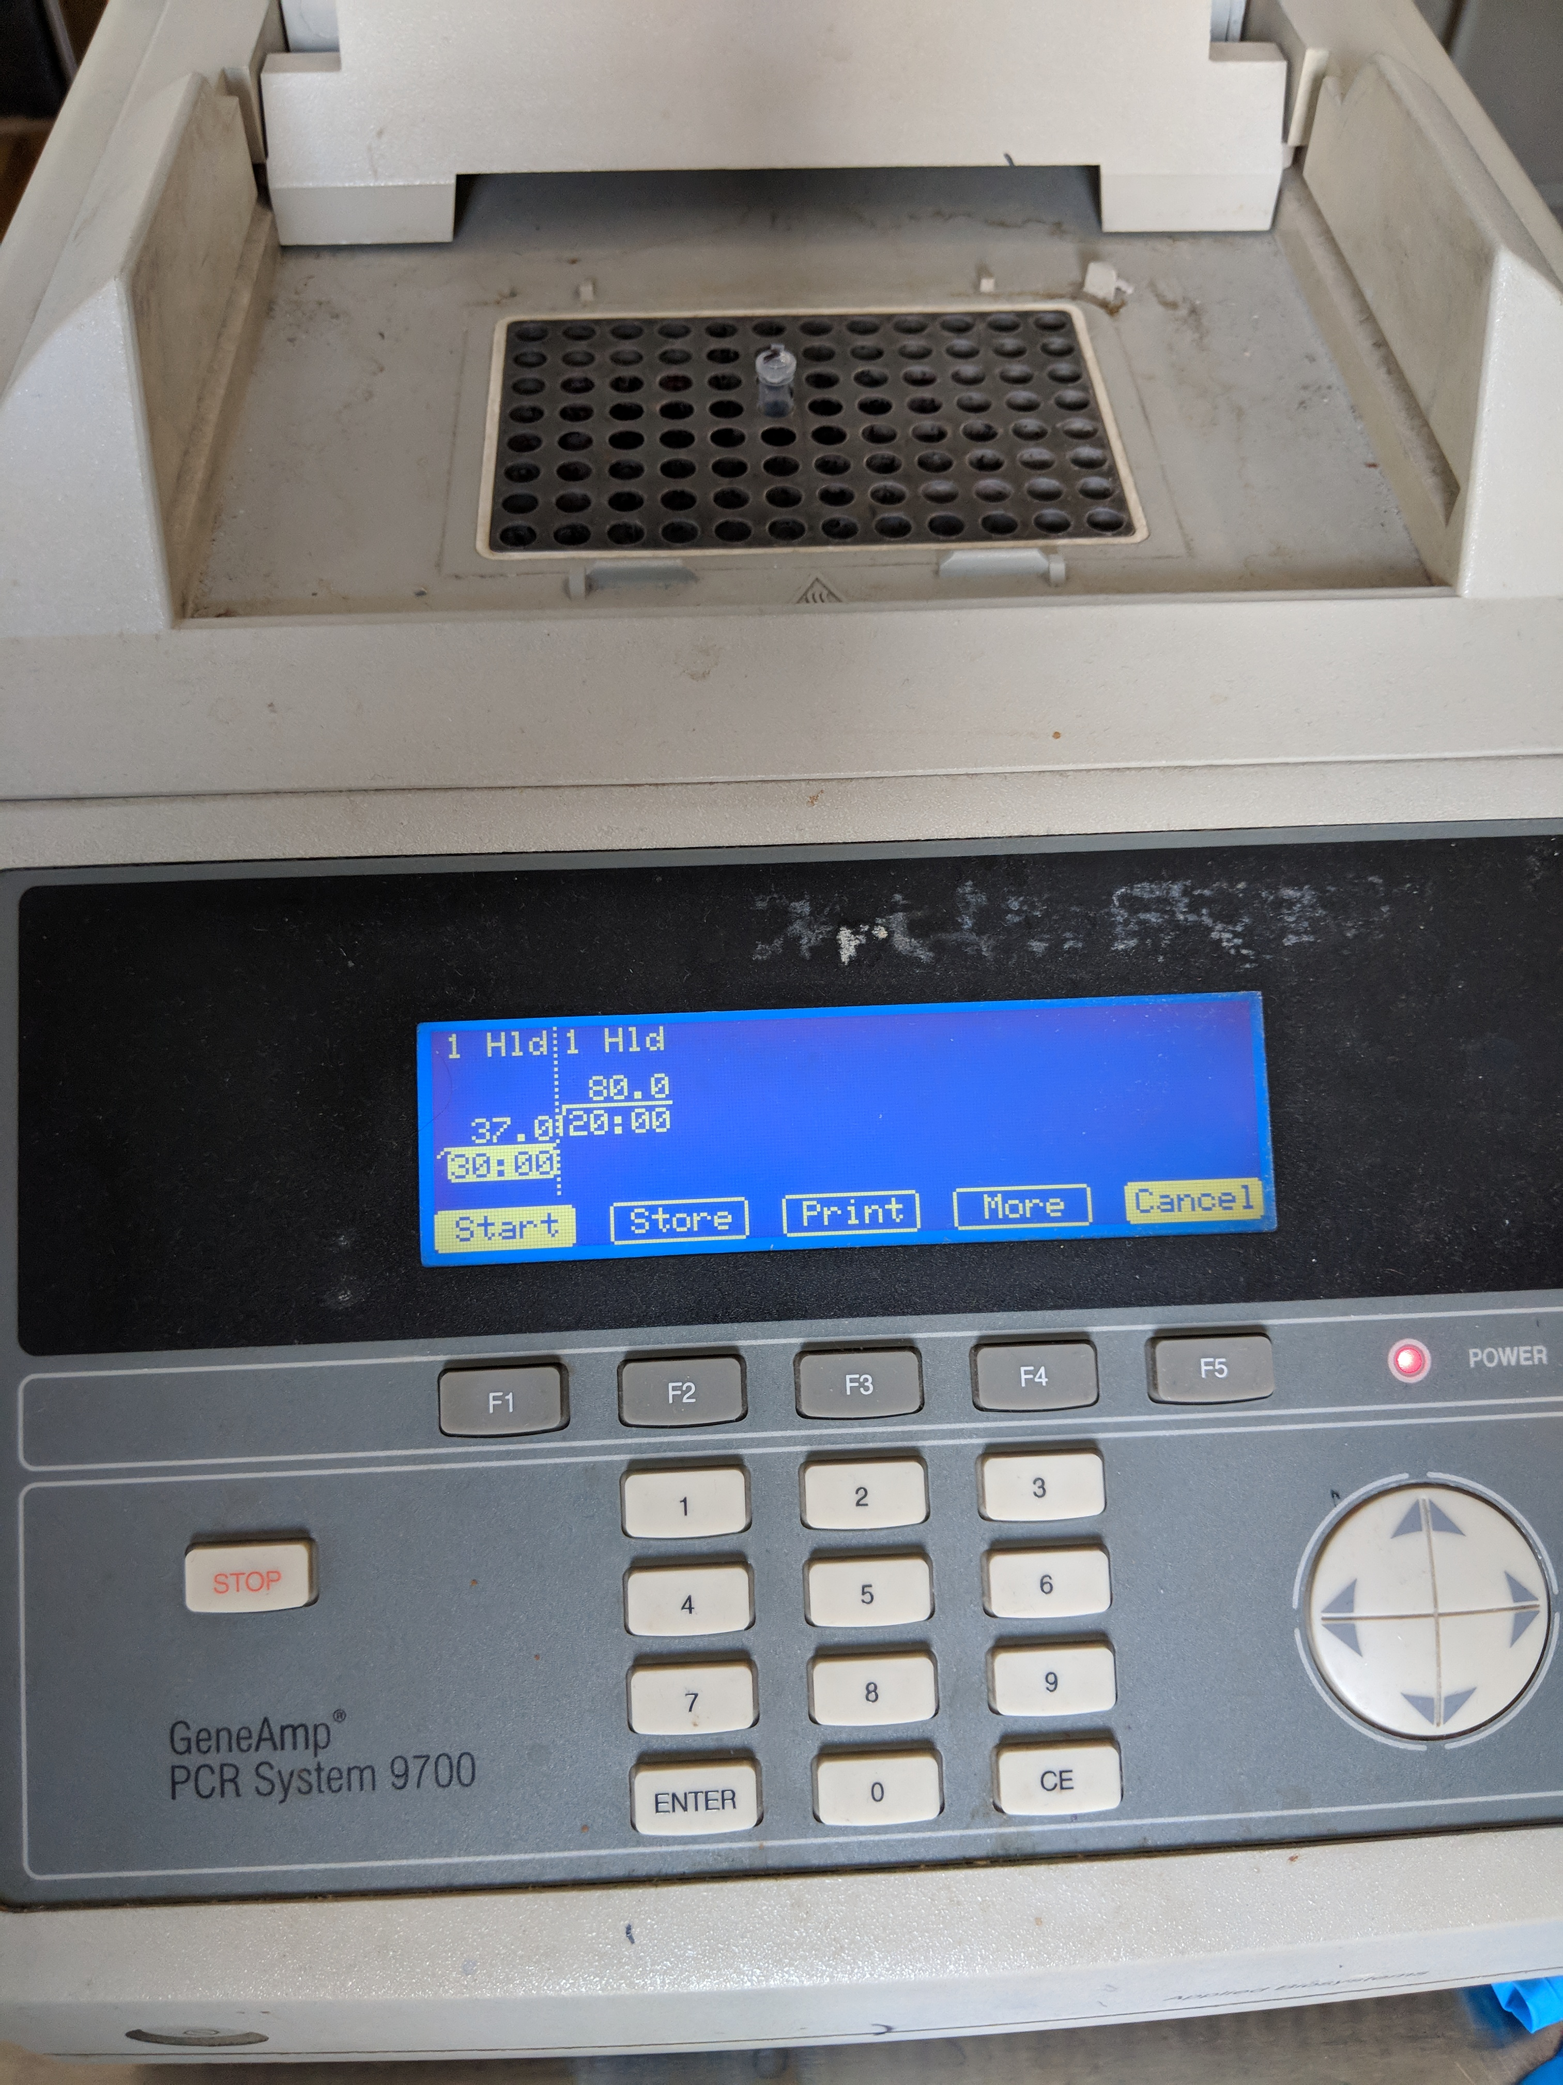
PCR Machine

Slide 66
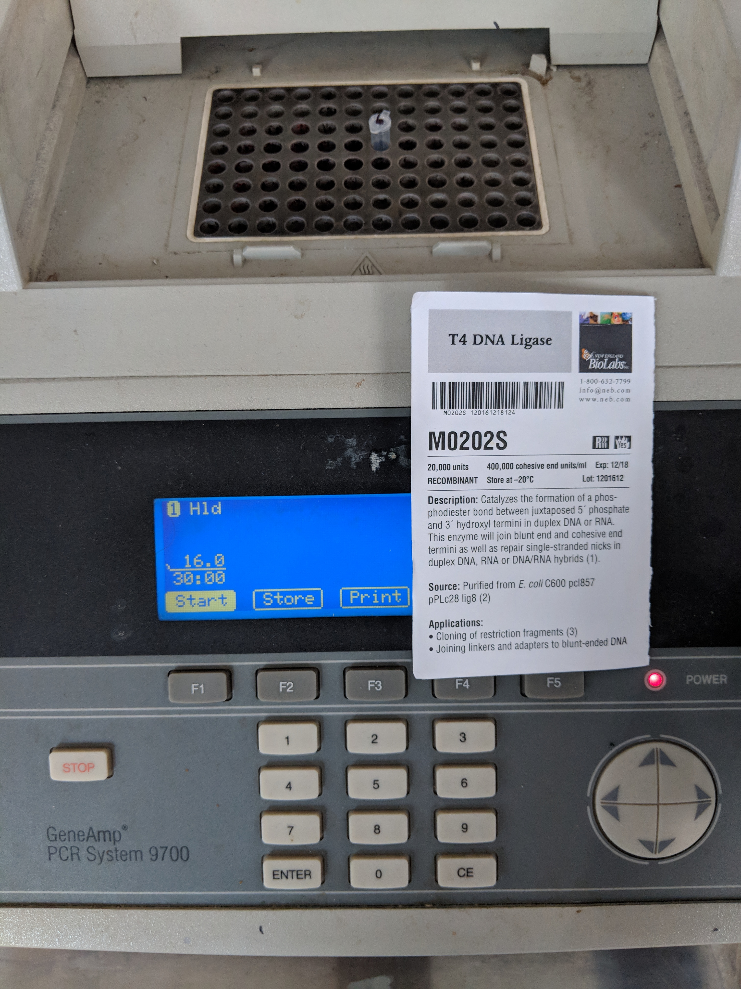
More PCR

Slide 67
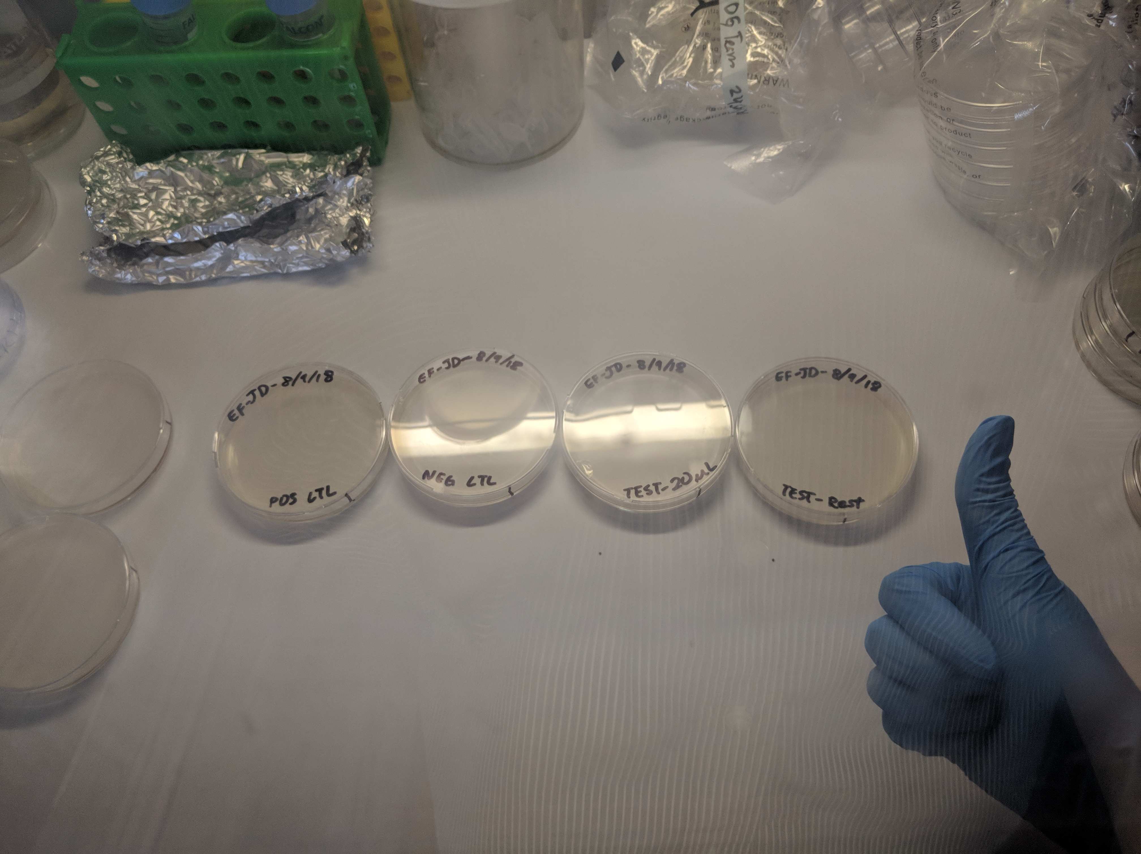
My plates

Slide 68
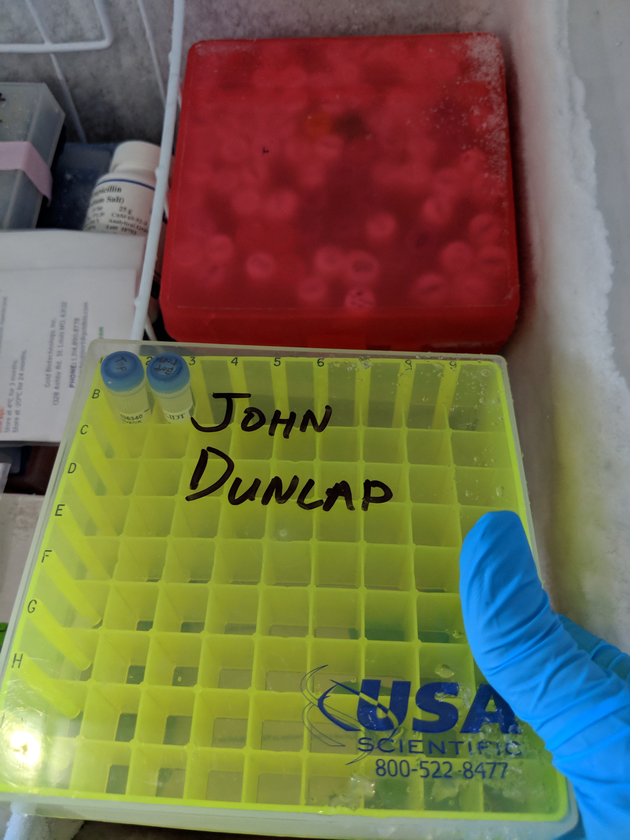
Holding the tubes

Slide 69
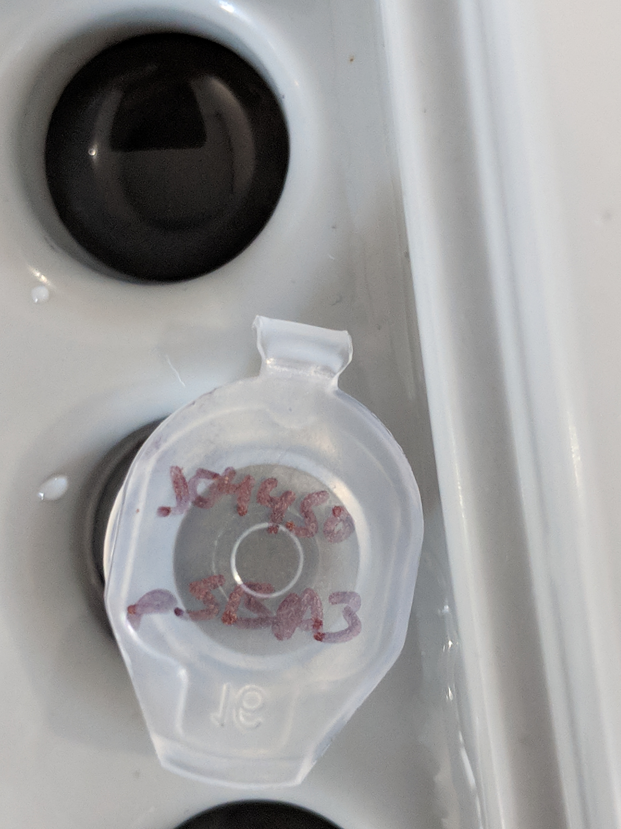
Getting ready to PCR

Slide 70
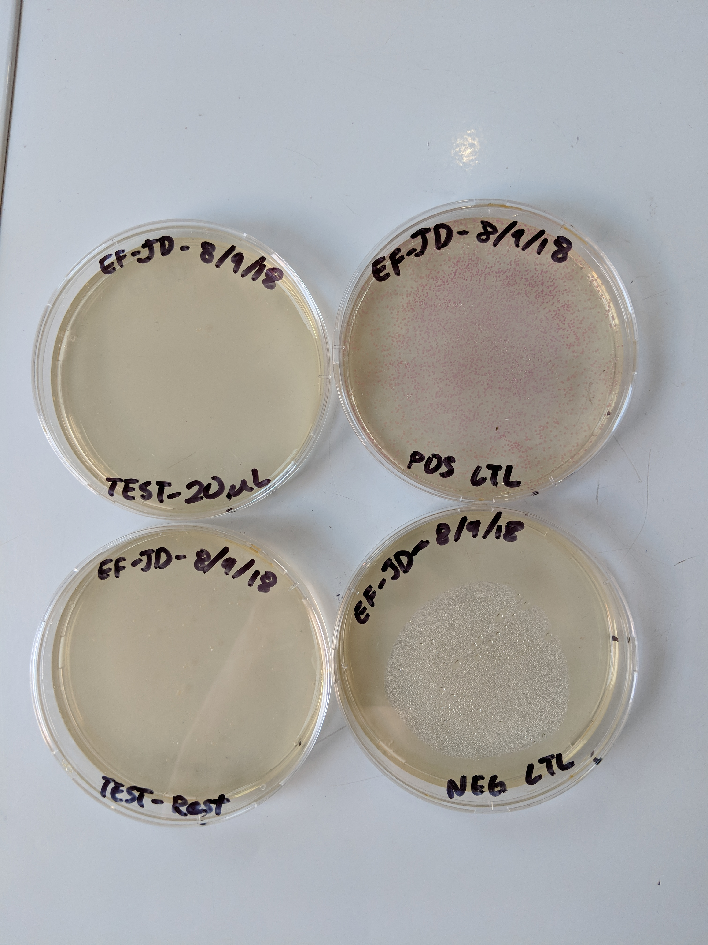
More plates

Slide 71
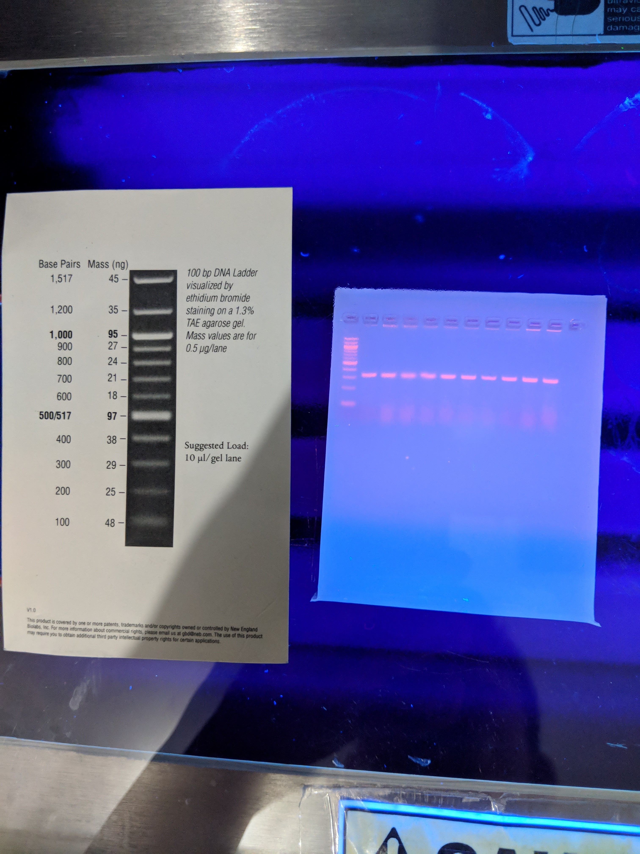
PCR Gels

Slide 72
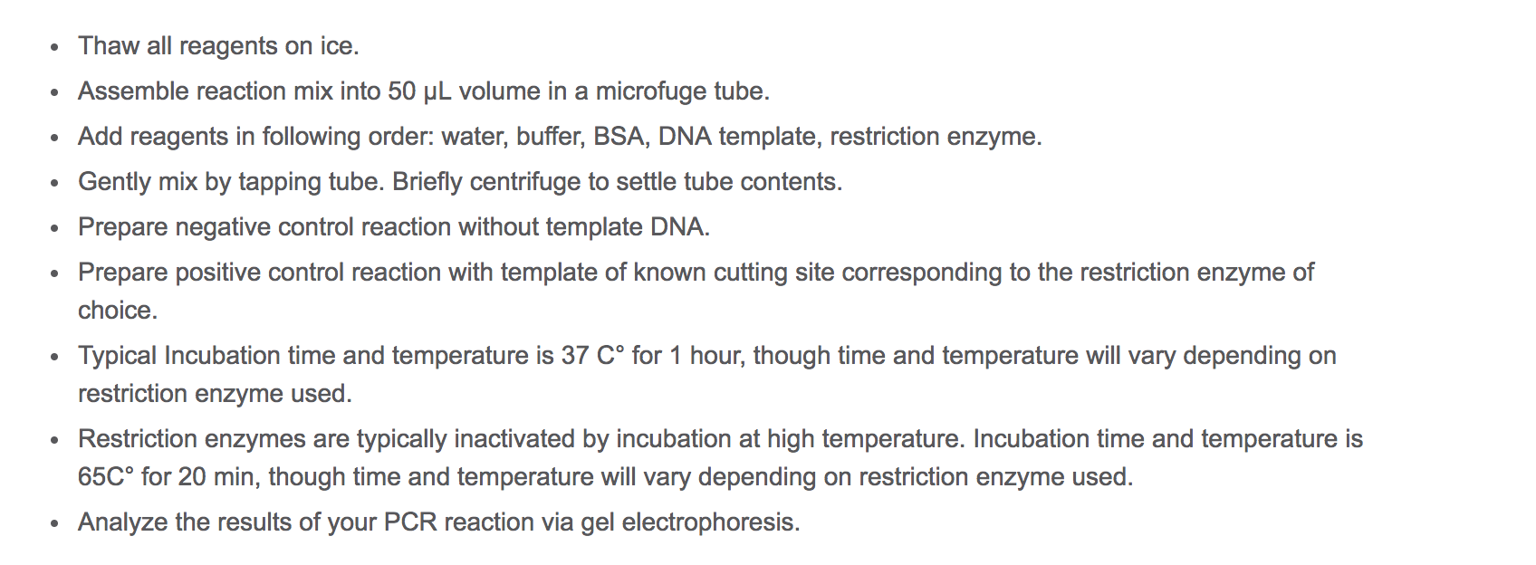
Genscript’s Protocol

Slide 73
There a lot of variations on the instructions
http://2009.igem.org/wiki/images/1/1d/PKU_DNA_digestion_protocol.pdf
https://www.addgene.org/protocols/restriction-digest/ - has a nice video of their protocol in action
https://www.thermofisher.com/us/en/home/life-science/cloning/restriction-enzyme-digestion-and-ligation.html
http://www.methodbook.net/dna/restrdig.html
Procedures are likely to vary a bit based on your setup

Slide 74
Step 7: Sequencing
Again, having a relationship with a legit lab is going to make this way easier
With my skillset/tools using a service was the only option
Costs much more money as you ask for more sequencing
Doing more prep/purification will lower the cost
Sending them a raw bacterial colony will cost a bit more
Roughly a few hundred dollars, give or take

Slide 75
Step 8: Interpret Results
The lab will send you a big list of nts
Things may have gone horribly wrong
You may have to try again

Slide 76
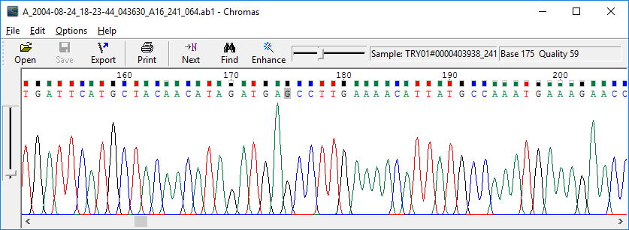
Chromatograph Readings

Slide 77
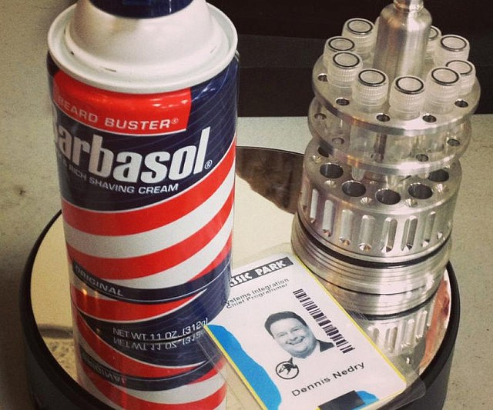
Now you can take your secret data anywhere (that’s cool with E.Coli)

Slide 78
Costs
Item | Cost (per 32 bytes of data)
Lab Membership | ~$300+ (ongoing)
Synthesis | $40
Lab expendables (enzymes etc…) | $200 (to get set up)
Sequencing | $300 (could be less in some places)
Total | ~$800

Slide 79
Benefits
No one will ever guess it’s in the bacteria.
Not an obvious storage medium
No one will ask you for key escrow on your pet bacteria
It would take a very dedicated effort to back door this one
The joy of birthing synthetic life
Lots of practice pipetting

Slide 80
Downsides
Pretty expensive
Slow
Key exchange sucks
Hard to say if your plasmid will survive for long in successive generations of bacteria. Likely will not offer a biological benefit. Natural selection may quickly degrade/remove it.
Can’t really do it without the involvement of several labs
There will be a lot of un-stealthy records/invoices.
Then again I can imagine organizations with an interest in stealth building labs for this sort of thing from scratch.

Slide 81
Cost per byte is a little high compared to on chip AES

Slide 82
My Aspirations for the Future
New model organisms
Try it with CRISPR
More elaborate algorithms
A viable method to package the living colony for stealthy transport
Some longish term bacterial husbandry to determine how well this bare bones method survives in the colony after successive generations
Error correction code implementation
Angering the lab people less with decreased begging for help

Slide 83
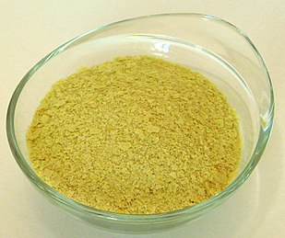
Yeast?

Slide 84
I Hope You Had Fun
If you are well informed molecular biologist, I am so sorry. This must be like when I watch CSI cyber.
The biohacking community is very supportive and you should get involved with it even if you don’t think you have the background
If you are a computer person there are a lot of fun bioinformatics projects to get involved with
If you are thinking of starting a community lab, please do. The world needs more.
Feel free to hit me up on github or @JohnDunlap2 if you have suggestions or questions about my project

Slide 85
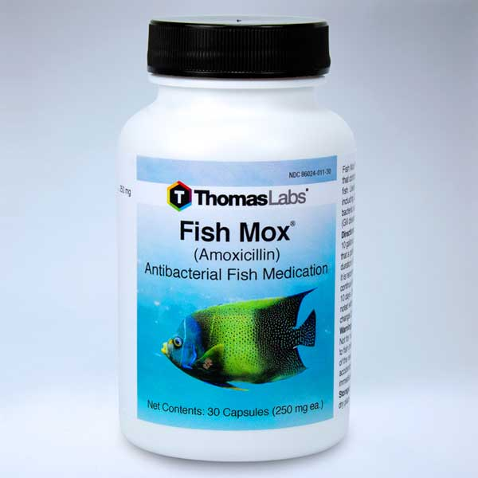
Happy Biohacking!

